Slide 1
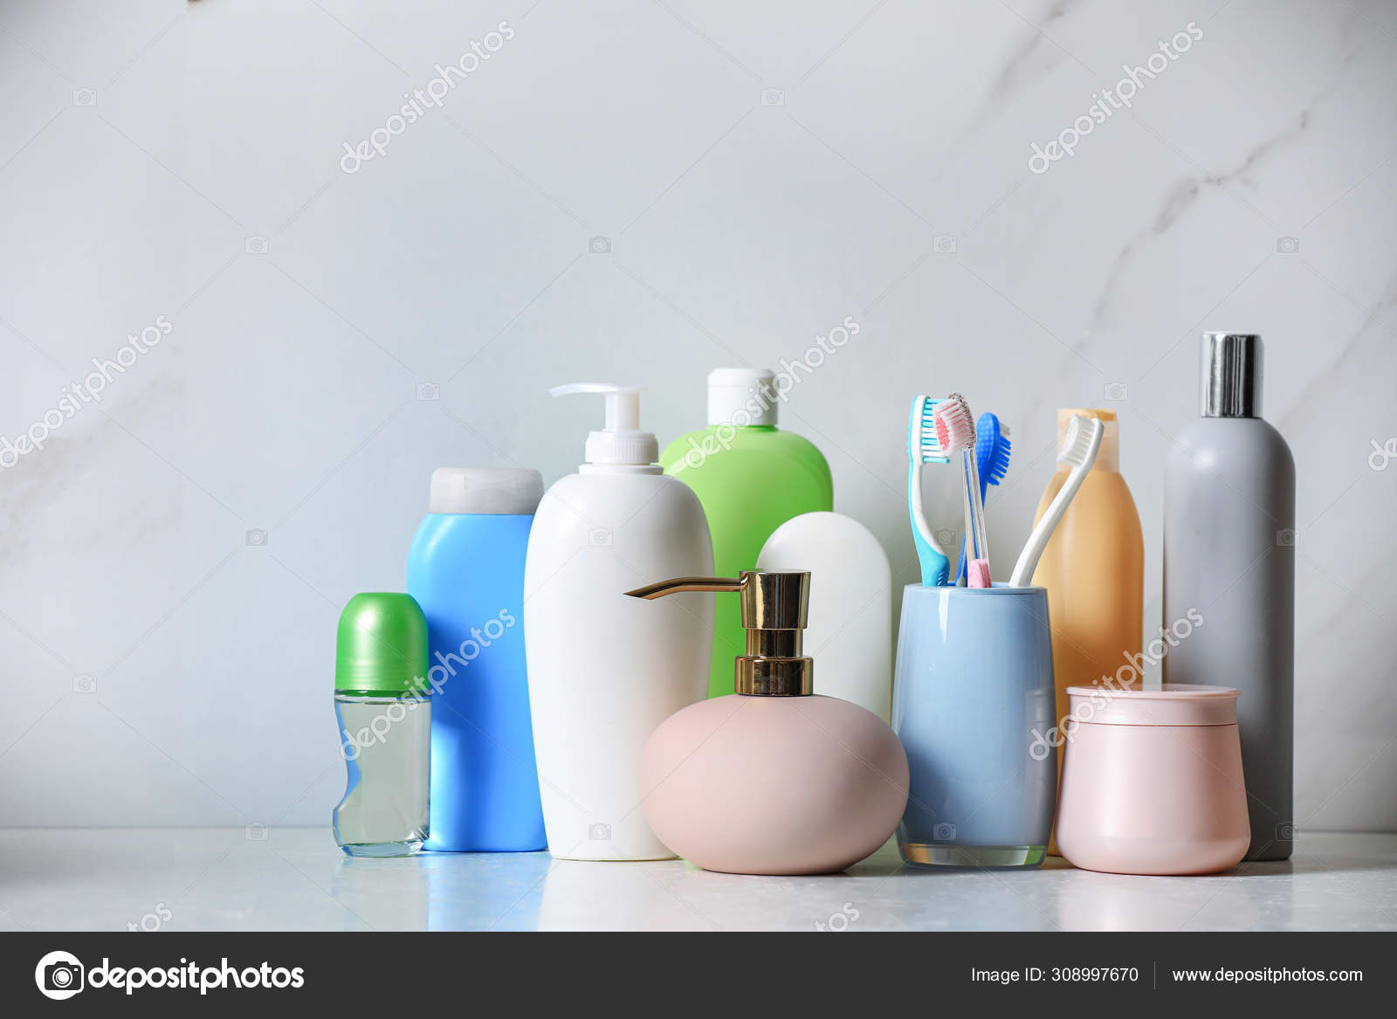
DEODORONT DATASET QUERY …
PRESENTED BY: SAURABH GANESH BORKAR

Slide 2
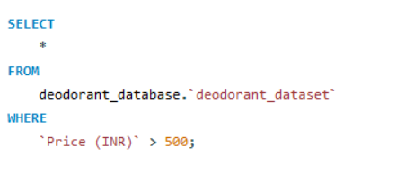
BASIC SQL QUESTIONS : Que 1. Retrieve all details of deodorants priced above 500 INR. Answer :

Slide 3
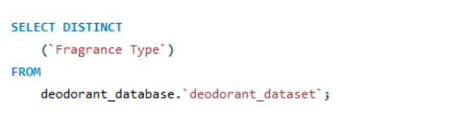
Que 2. List distinct fragrance types available in the dataset. Answer :

Slide 4
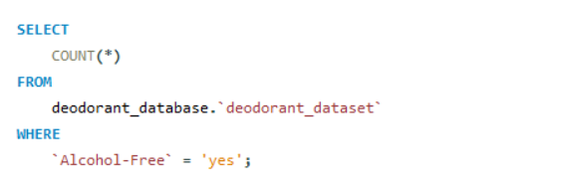
Que 3. Count the number of deodorants that are alcohol-free. Answer :

Slide 5
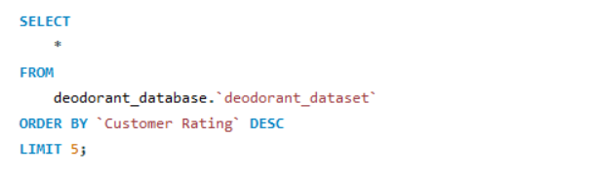
Que 4. Retrieve the top 5 highest-rated deodorants. Answer :

Slide 6
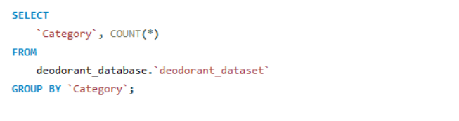
Que 5. Show the number of deodorants available for each category (Men, Women, Unisex). Answer :

Slide 7
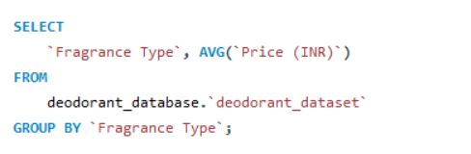
Intermediate SQL Questions: Que 1. Find the average price of deodorants for each fragrance type. Answer :

Slide 8
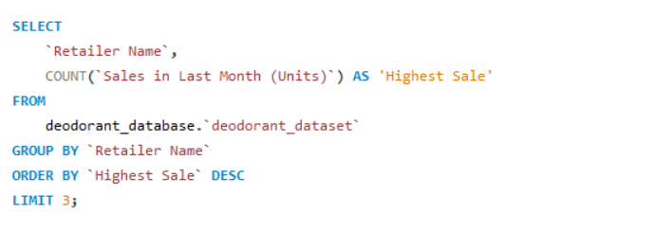
Que 2. Retrieve the top 3 retailers with the highest number of sales in the last month. Answer :

Slide 9
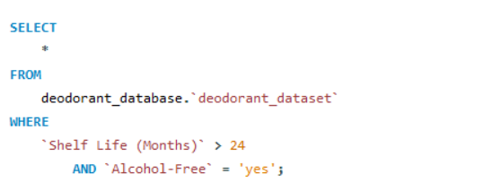
Que 3. List deodorants that have a shelf life of more than 24 months and are also alcohol-free. Answer :

Slide 10
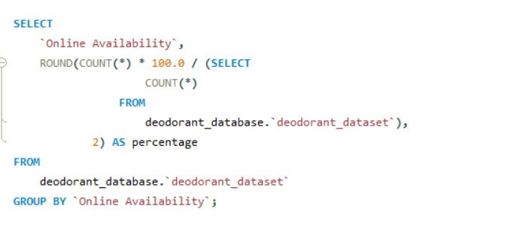
Que 4.Show the percentage of deodorants available online vs. offline. Answer :

Slide 11
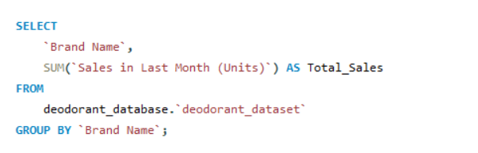
Que 5. Find the total sales in the last month for each brand. Answer :

Slide 12
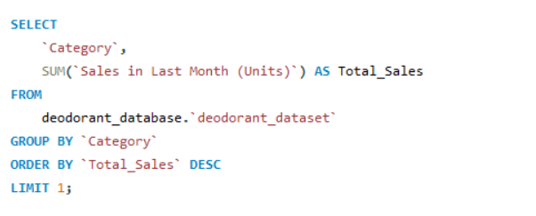
Advanced SQL Questions : 1.Identify the most popular deodorant category based on total sales in the last month. Answer :

Slide 13
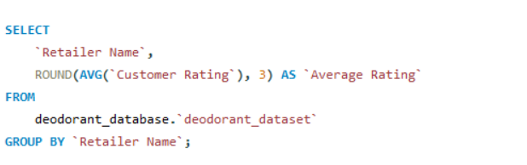
2. Calculate the average customer rating for each retailer. Answer :

Slide 14
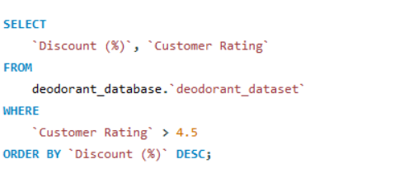
3. Find the deodorants with the highest discount but still have a customer rating above 4.5. Answer :

Slide 15
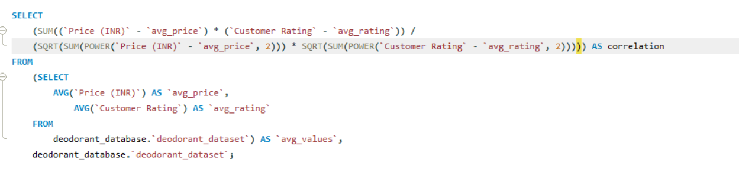
Que 4. Determine the correlation between price and customer rating using SQL queries Answer :

Slide 16
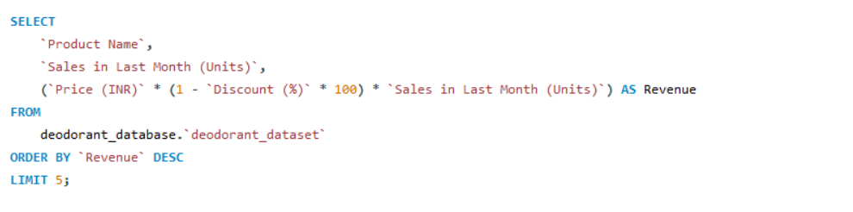
Que 5. List the top 5 best-selling deodorants along with their revenue generated after applying discounts. Answer :

Slide 17
THANK YOU !!!

